Slide 1
School Manager API
FastAPI & SQLAlchemy Project
Osamah Algadami

Slide 2


Slide 3
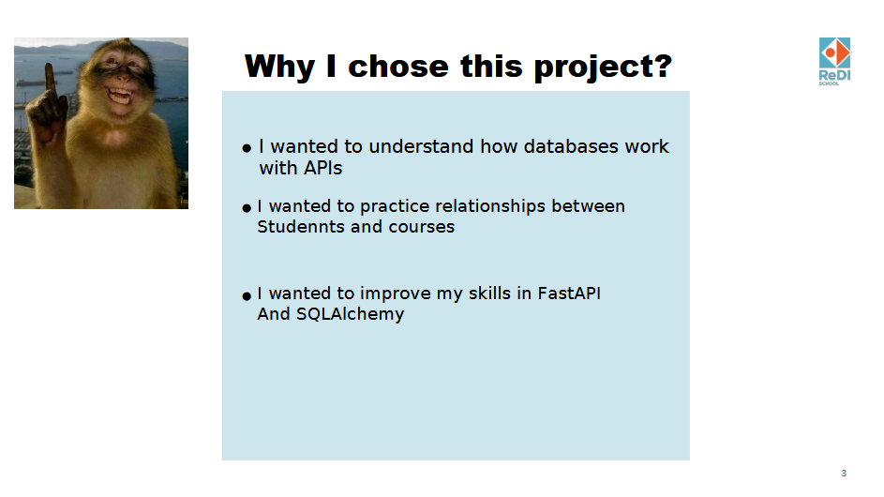

Slide 4


Slide 5
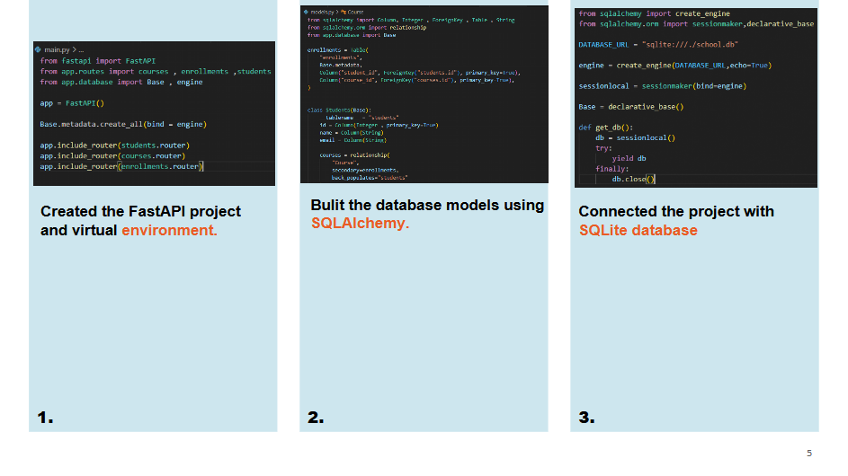

Slide 6
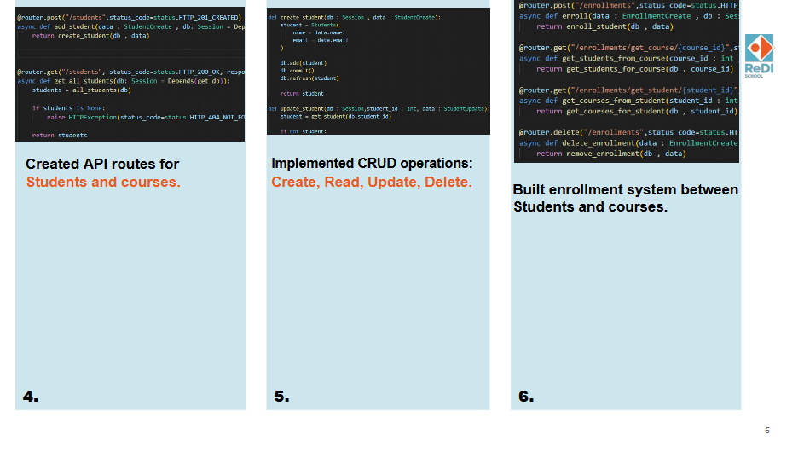

Slide 7


Slide 8
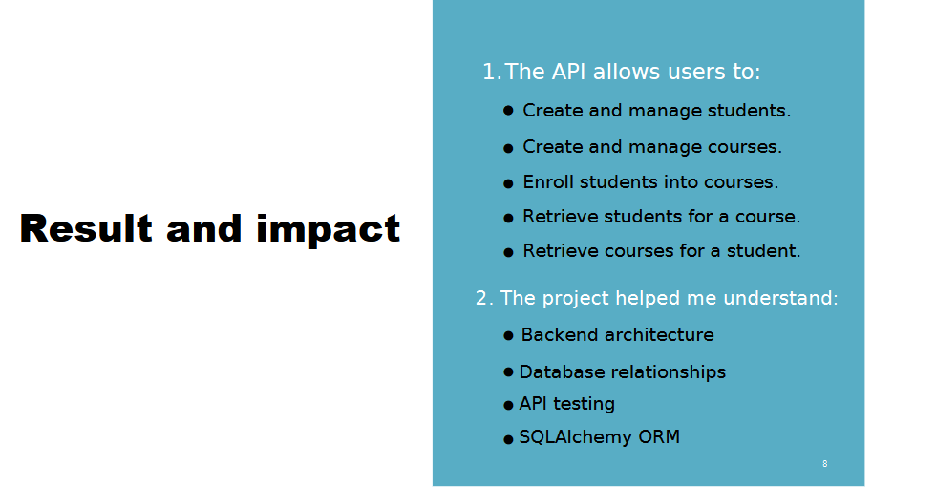

Slide 9


Slide 10
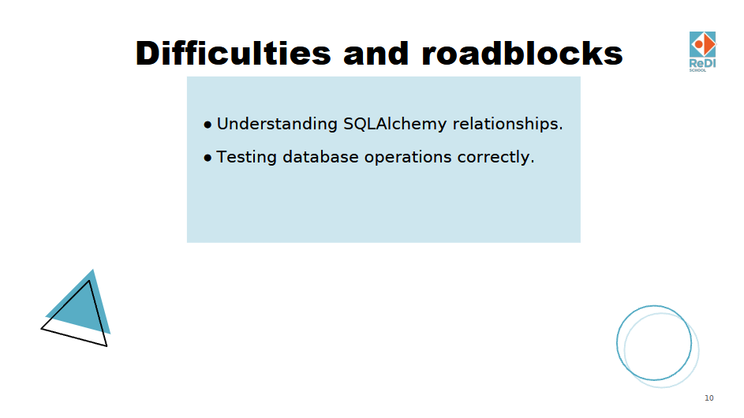

Slide 11


Slide 12
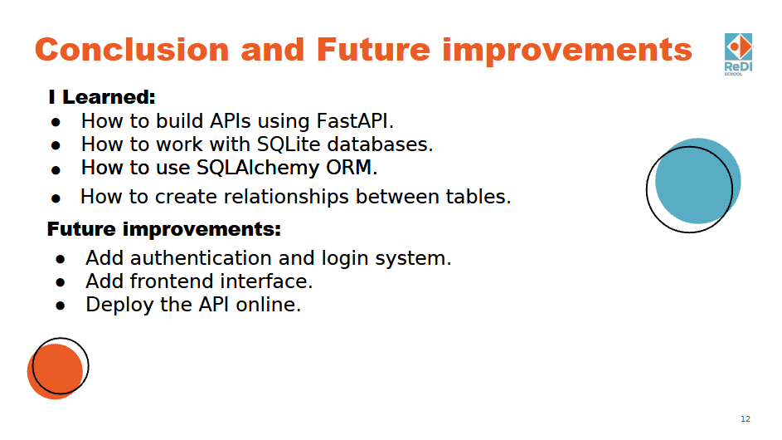

Slide 13

Thanks a lot!
Augusting Osamor

